Slide 1
Project Citizen
Class Competition: April 24th
School Competition: April 28th
State Competition: May 8th

Slide 2
Project Citizen: What Is It?
You will be researching a problem that faces our school or community and propose a solution to solve it.
It is a group project. I have you in groups of 5-6.
Each group member MUST CONTRIBUTE to the success of your group.
So what is the final product?
  You will present a Power Point presentation to the class.
  The winning team in class (class vote and my vote) will represent our class at the school competition on Wed, May 2nd.
  The winning team from our school will go to the state Capitol on Friday, May 11th to compete against other high schools across the state.

Slide 3
But First…
As a class we need to understand what “public policy” is.
Public policy is a plan that the community follows to help solve a problem.
Usually this an issue that is brought up by citizens, like you and me, because we think that something should be done.
Public policy issues are things like…
  Litter clean up
  Community safety issues
  Welfare and poverty
  Teen pregnancy
  Youth suicide.
  Project Citizen Video Clip

Slide 4
Public Policy and Public Service Announcements
In government class, we’ve learned the role citizens play in everyday life.
People like you and me, more so than government, can make a difference in our community.
The “Ad Council” is an organization of Federal Government whose purpose is to inform the public about issues facing young people.
This organization broadcasts “Public Service Announcements” (PSAs).

Slide 5
PSA
The Ad Council has television, radio and internet ads informing the public of issues that affect us. Here are some:
Public Service Announcements

Slide 6
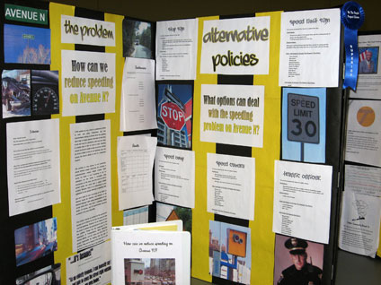
Project Citizen: What Is it?
Project Citizen is like your own “PSA”, but in much greater detail and with an outcome/solution.
Your presentation is broken down into 4 sections:
  Problem
  Alternatives
  Policy
  Action Plan

Slide 7
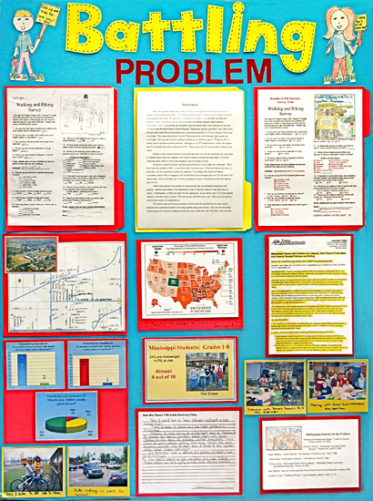
Problem
This section is research on the issue (problem) your group chose.
You need to explain…
  Why this is an important issue facing our school/community?
  How does it impact people?
Background, statistics, news articles, personal stories, etc…

Slide 8
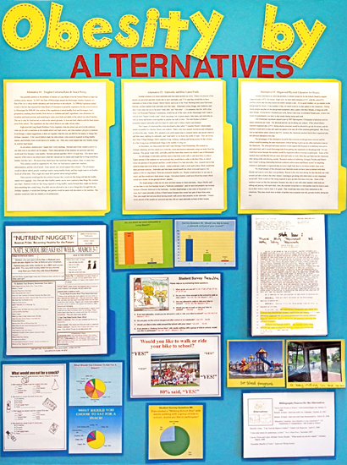
Alternatives
In this section you will research alternatives that can provide a solution to your problem.
This can be alternatives already out in the public, or ideas you have up with.
You need 3 alternatives. You must research the pros and cons of each and also state what level of government is responsible (local, state, school board, etc.)

Slide 9
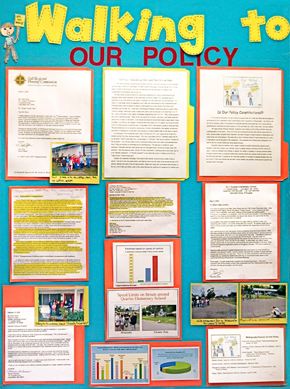
Class Policy
In this section you need to chose out of the 3 alternatives, which one you choose to be the policy that offers the best solution to your problem.
You need to also list advantages and disadvantages.

Slide 10
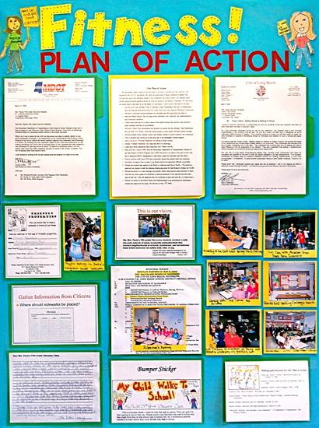
Action Plan
Finally, your final section is the “Action Plan”
This is the plan you would take to implement your policy.

